Slide 1
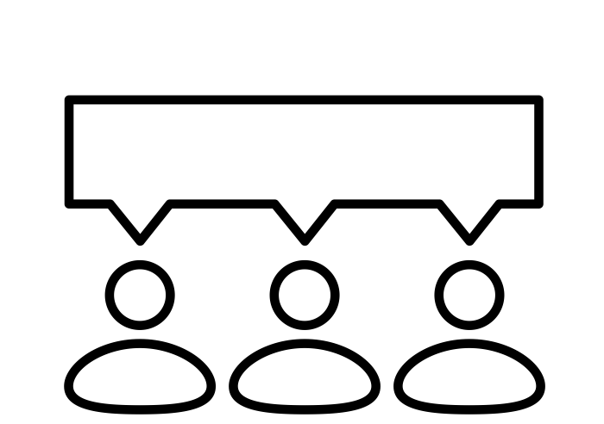
Infrared Camera
Sensing System
Based on Artificial Intelligence
Infrared Camera Sensing System
Based on Artificial Intelligence
First Project
20192 Capstone Design Project 1 - Team7
Copyrightⓒ. Saebyeol Yu. All Rights Reserved.
Notes:
Post processing of data from infrared camera sensing system by using Artificila Intelligence

Slide 2
Contents
001
What is Our Project?
Introduction to Partner Company
Introduction to Project
002
Who are we?
Introduction to Team Members
003
How to develop?
Our Project Overview
Merits of Our Project
004
When will be finished?
Our Schedule
Our Meeting
Notes:
Benefits of Our Project -> Merits of Our Project (민철)
Introduce Our Project // 이렇게 동사형으로 쓰는것 보다
Introduction to our project // 이렇게 명사형으로 쓰는게 어떨까
When is It finished? // 이거보단 미래시제로 when will be finished? 이렇게 쓰면 어떨까

Slide 3
001
What is Our Project?
Copyrightⓒ. Saebyeol Yu. All Rights Reserved.

Slide 4

1
001 What is Our Project?
Introduction to Partner Company
JC RADAR Inc.
JC RADAR Inc. is an artificial Intelligence-based radar/thermal-camera specialist.
Main business is industrial radar, medical/health radar, and thermal imaging camera research and manufacturing, sales
Key development Items:
Body’s breathing/Heartbeat measurement radar
Laser Distance/Speed Meter
AI-based radar/thermal-camera
Micro Array Antenna
AI-Based Radar/Camera Pioneer
Copyrightⓒ. Saebyeol Yu. All Rights Reserved.
Notes:
Pioneer를 Developer로 바꾸는 건 어때? 조금 어색한 거 같은데 (민철) // 나는 나쁘지 않은 것 같음 하지만 The pioneer of AI-Based Radar/Camera 로 바꿨 으면함

Slide 5
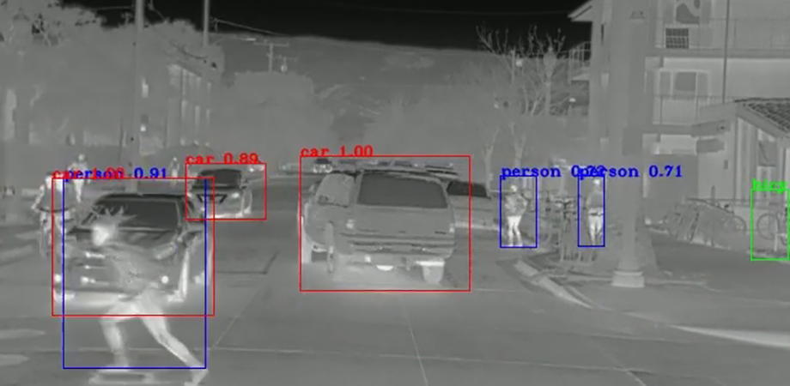
1
001 What is Our Project?
Introduction to Project
Infrared Camera Sensing System
Based on Artificial Intelligence
Object Recognition
Intent Classification
Camera Control
Change Monochrome Photo to Color Photo
Copyrightⓒ. Saebyeol Yu. All Rights Reserved.

Slide 6
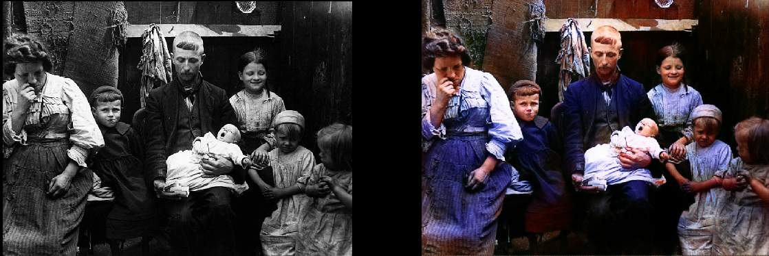
1
001 What is Our Project?
Introduction to Project
Monochrome Image
Color Image
Copyrightⓒ. Saebyeol Yu. All Rights Reserved.
Notes:
Photo -> Image (민철)

Slide 7
002
Who are we?
Copyrightⓒ. Saebyeol Yu. All Rights Reserved.

Slide 8
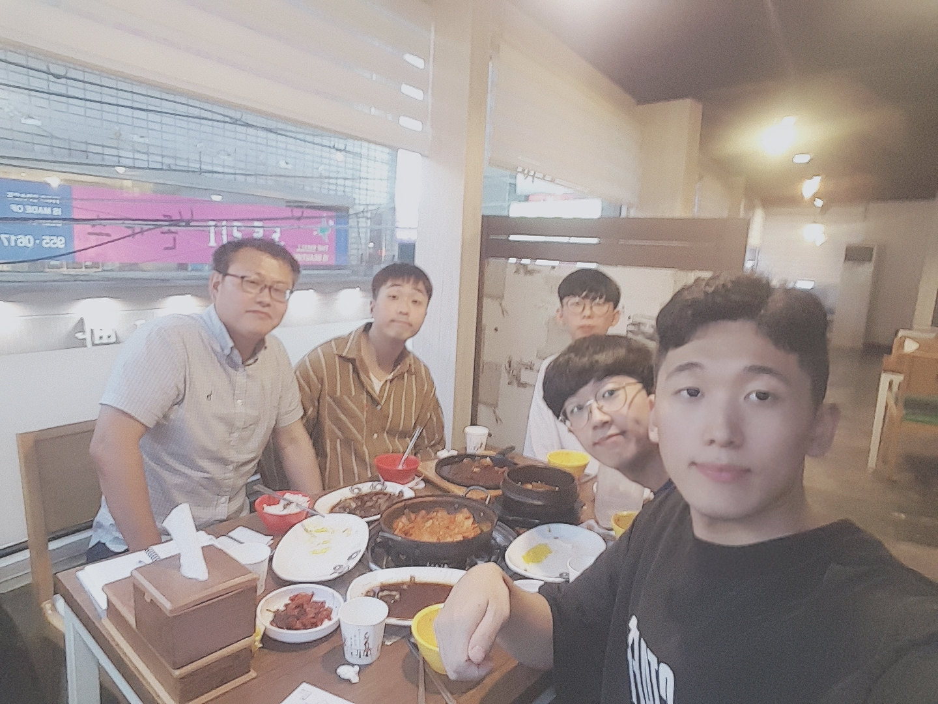
2
002 Who are we?
Introduction to Team Member
Hong Seong-Gi
# KNU CSE 15
# Market Leader
# Market Survey
# Android # App
Lee Cherl-Hee
# Project Mentor
# JC RAdAR CEO
# Mentor # Support
Kwon Min-Cheol
# KNU CSE 15
# Knowledge Leader
# Information Provision
# Infrared Camera
# Server # AWS
Kim Hee-Won
Park Myeong-Hun
# KNU CSE 15
# Technology Leader
# Technology Survey
# Machine Learning
# Object Dectection # AI
# KNU CSE 15
# Project Leader
# Guiding Team Members
# Machine Learning
# Intent Classification # AI
Copyrightⓒ. Saebyeol Yu. All Rights Reserved.

Slide 9
003
How to develop?
Copyrightⓒ. Saebyeol Yu. All Rights Reserved.

Slide 10
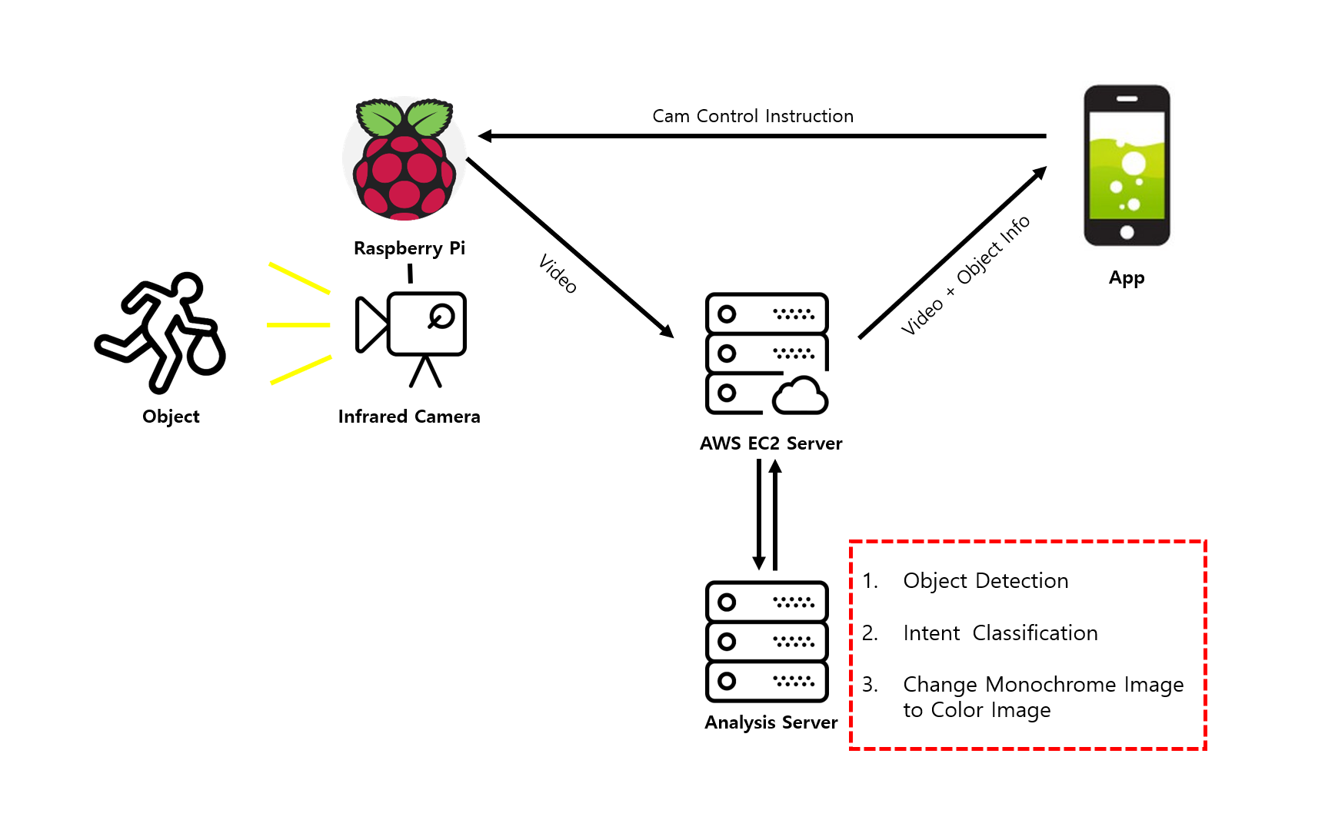
3
003 How to develop?
Our Project Overview
Copyrightⓒ. Saebyeol Yu. All Rights Reserved.
Notes:
Control Instruction을 Cam control Instruction 처럼 카메라를 조작한다는 걸 명시해주면 더 좋을 것 같기도 해? (민철) // 이건 발표로 커버되는 내용이고 더 포괄적인 내용을 뜻하는 Control Instruction 이 좋아보임

Slide 11
3
003 How to develop?
Merits of Our Project
High Recognition Rate
Increase Camera quality
Intent Classification
Change Monochrome Image to Color Image
Camera Remote Control
Copyrightⓒ. Saebyeol Yu. All Rights Reserved.
Notes:
Benefit of Our Project -> Merits of Our Project (민철)

Slide 12
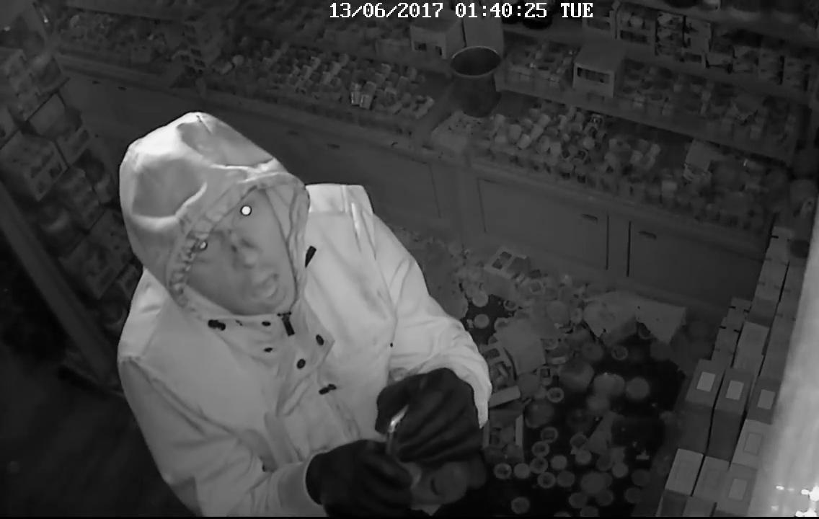
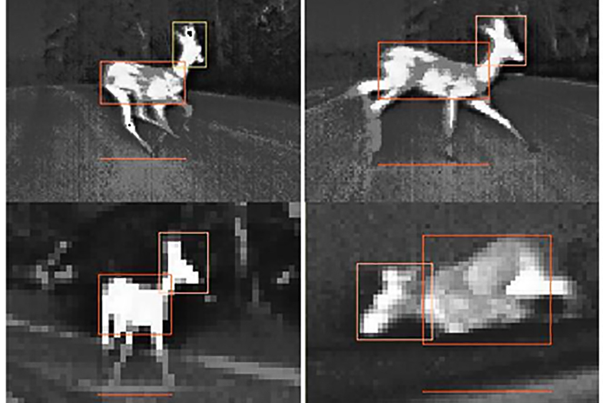
3
003 How to develop?
Merits of Our Project
Innovative CCTV
Animal Detect & Observation
Notes:
Animal Detect → Animal Detection

Slide 13
004
When will be finished?
Copyrightⓒ. Saebyeol Yu. All Rights Reserved.

Slide 14
4
004 When is It finished?
Our Schedule
Identify Requirement
Problem Recognition
Market Survey
Technical Survey
Requirement Analysis
Priority
Software Design
Step1
Step3
Planning
Design
Specify Requirements
Identify System Structure
Development
Verification & Validation
Step2
Step4
Analysis
Implementation
* Software Development Life Cycle – Waterfall Model
Notes:
Identify Requirement → Requirements Analysis

Slide 15
4
004 When is It finished?
Our Schedule
September
Planning
Analysis
Design
Implement
October
Implement
Patent
Thesis
November
Patent
Thesis
Announcement

Slide 16
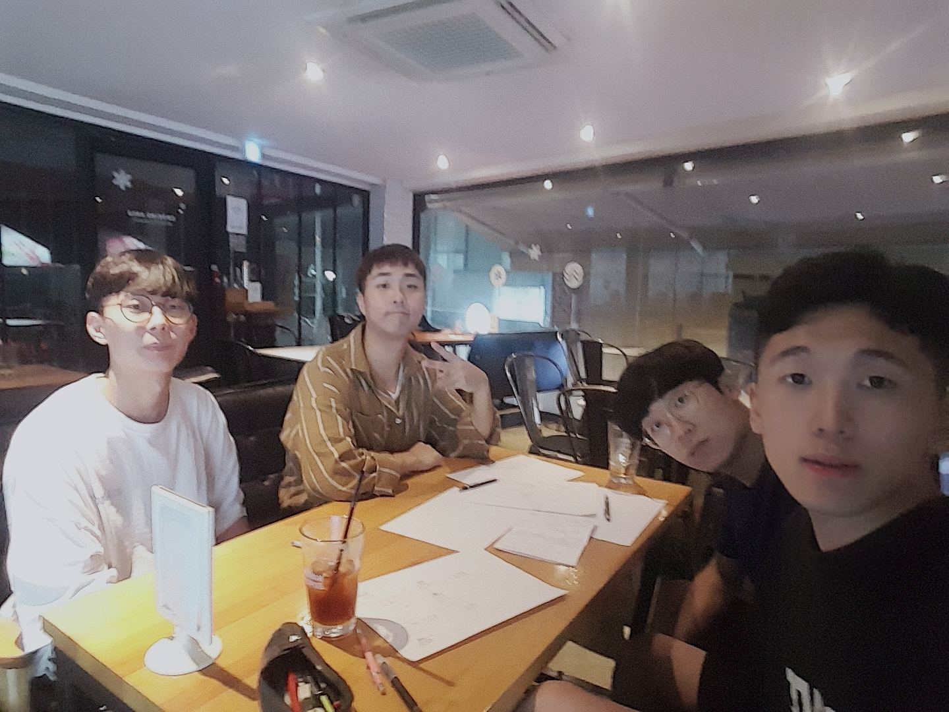
4
004 When is It finished?
Our Meeting
2019. 09. 05 | First Meeting
Identify Business Requirements
Problem Recognition
Propose Idea
Brainstorming
Havana Cafe, Kyungpook National University North Gate, Daegu
Notes:
Identify Company Requirements -> Identify Business Requirements (민철)

Slide 17
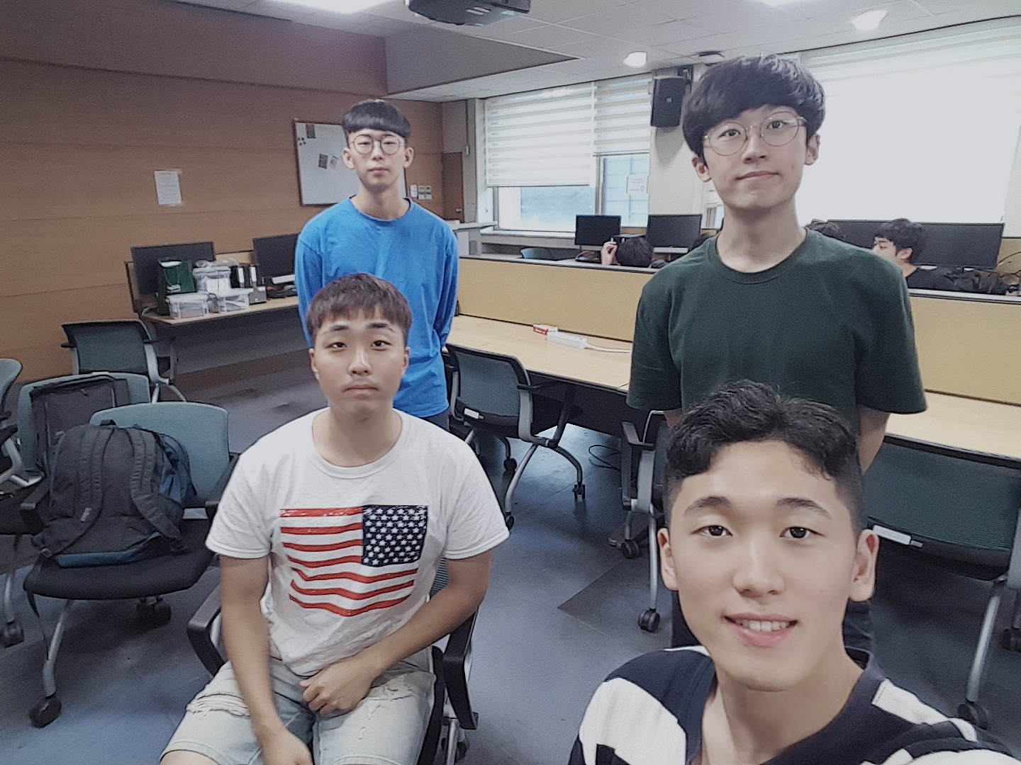
4
004 When is It finished?
Our Meeting
2019. 09. 07 | Second Meeting
Identify Additional Business Requirements
Specify Requirements
Propose Idea
Project Analysis
Building 406, Kyungpook National University, Daegu
Notes:
Identify Additional Company Requirements -> Identify Additional Business Requirements (민철)

Slide 18

Thank You.
Copyrightⓒ. Saebyeol Yu. All Rights Reserved.

